Slide 1

Entrepreneur’s and their Characteristics!

Slide 2
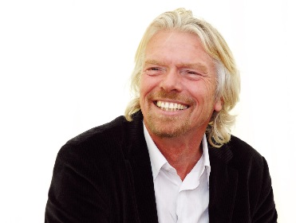
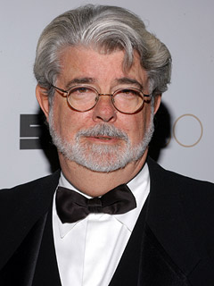
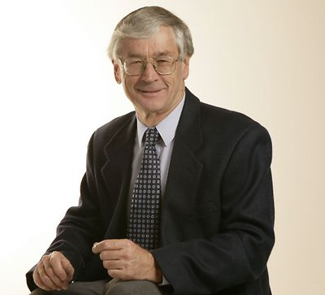
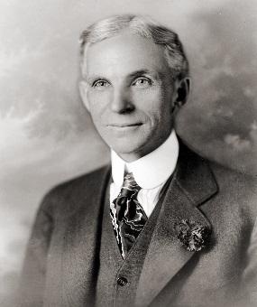
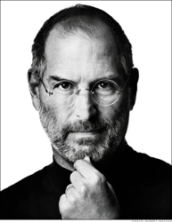
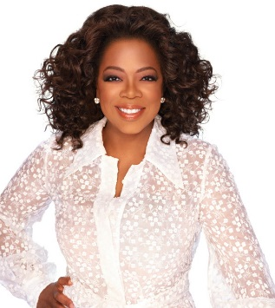
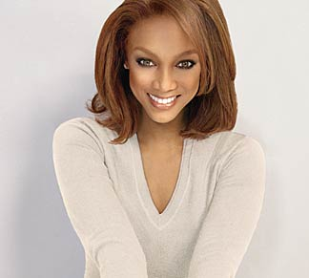
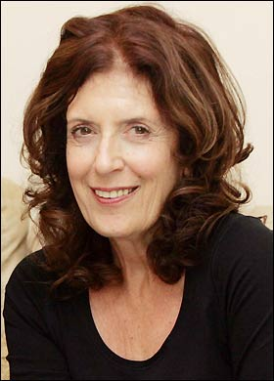
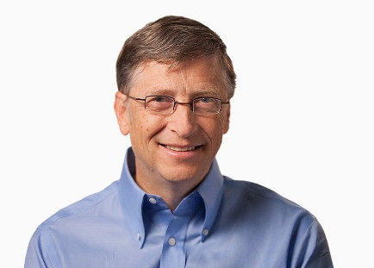
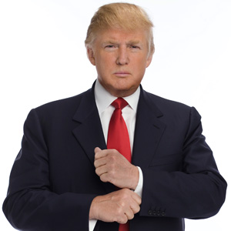
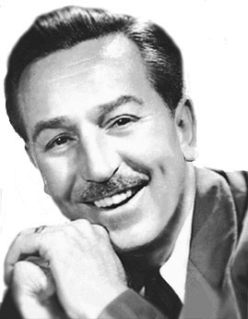
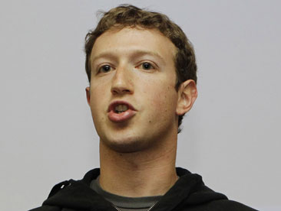
Can you match these famous faces to the logo they are famous for?

Slide 3












1
2
3
4
5
6
7
8
9
10
11
12

Slide 4
1
2
3
4
5
6
7
8
9
10
11
12

Slide 5
What is an Entrepreneur?
“A person who organises and manages any
enterprise, especially a business, usually with
considerable initiative and risk.”
(Dictionary.com, 2014)

Slide 6
What qualities do you think have lead all of these Entrepreneurs to be successful?

Slide 7
Brainstorm
In groups you will move to each station and write down words, examples and what you think the CHARACTERISTIC means.
Each group will have 1 minute before they move to the next station.

Slide 8
What makes an Entrepreneur?
Peter Jones’s 10 rules for Entrepreneurial Success

Slide 9
Concluding questions…
Which characteristics do you believe are the most important?
Which characteristics do you think you possess?
Who in the class do you think is most like an Entrepreneur?

Slide 10


Slide 11


Slide 12
Famous Failures!
https://www.youtube.com/watch?v=zLYECIjmnQs

Slide 13
References
Dictionary.com. 2014. Entrepreneur. Retrieved from http://dictionary.reference.com/browse/entrepreneur
Jones, P [ThisisPJTV]. (2008, January 8). Peter Jones’s ten rules for entrepreneurial success. [Video file]. Retrieved from http://www.youtube.com/watch?v=Tod1moy8VZM&feature=related
Image Credits:
http://andysacker.com/the-top-3-rules-on-becoming-a-rebel-entrepreneur/
http://carey.jhu.edu/one/2010/fall/the-mind-of-the-entrepreneur/

